Slide 1
Async and Streaming JS - Are we doing it WRONG?
Matthew Podwysocki @mattpodwysocki
https://github.com/mattpodwysocki/jsconfeu-2014
Notes:
Alright, we’re here for an Rx talk!
Hi, I’m Matthew Podwysocki from Microsoft
Now the title of this talk is a rather long one called Democratizing event processing at all scales and platforms with the Reactive Extensions or …

Slide 2
Or "I thought I had a problem. I thought to myself, "I know, I'll solve it with callbacks and events!". have Now problems. two I
Notes:
Or "I thought I had a problem. I thought to myself, "I know, I'll solve it with callbacks and events!". have Now problems. two I

Slide 3
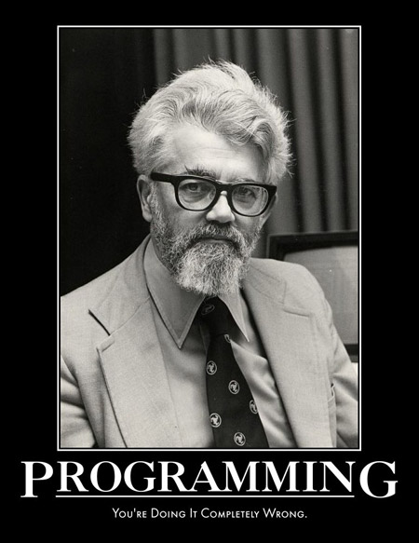

Slide 4

Notes:
This is not going to be a typical Erik Meijer style talk where there will be no mention of monads, no category theory harmed during this presentation. And lastly, no, monads are not like burritos.

Slide 5

Software Engineer Open Sourcerer @mattpodwysocki github.com/mattpodwysocki

Slide 6


Slide 7

Rx
@ReactiveX
github.com/Reactive-Extensions

Slide 8

A Software Developer’s Hardware Conference
December 6th – 7th 2014
http://robotsconf.com/

Slide 9
Asynchronous Programming is Annoying
Every library has a different way of doing async/events
Callbacks are different from Promises, from events, etc
Each concept covers only part of the story
Wouldn’t it be great to have a unifying concept to generalize how we think about concurrent/reactive programming?
Notes:
Each programming language and platform has its own way of expressing ways of getting data via asynchronous programming and events. By themselves, asynchronous and event-based programming is fine as it is per runtime for doing one and only one thing. But they’re ultimately different worlds. Each of these cover its own part, Promises for example for single values, and events for multiple values. You wouldn’t use a promise over events that you might expect more than one.
To make this more concrete, say we need to make a web request to get some data, now let’s combine it with some user input from keystrokes which are events. Now, what if we need to then add a timer so we don’t overload the service? How do we do that?
We just worked with three concepts here, promises, events and timers.
So, wouldn’t it be nice to have a unifying concept over the entire space that we just described?

Slide 10
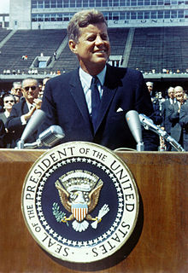
We choose to go to solve asynchronous programming and do the other things, not because they are easy, but because they are hard
Former US President John F. Kennedy - 1962
[citation needed]
Notes:
http://en.wikipedia.org/wiki/We_choose_to_go_to_the_Moon

Slide 11

Callback Hell
function play(movieId, callback) {
var movieTicket, playError,
tryFinish = function () {
if (playError) {
callback(null, playError);
} else if (movieTicket && player.initialized) {
callback(null, ticket);
}
};
if (!player.initialized) {
player.init(function (error) {
playError = error;
tryFinish();
}
}
authorizeMovie( function (error, ticket) {
playError = error;
movieTicket = ticket;
tryFinish();
});
});
Notes:
Now callback hell is a very real thing. If you’ve been in the JavaScript world long enough, then you’ve had to deal with trying to do sequential processing of some sort with asynchronous code. Trying to find the logic versus fighting the callback nature, it’s easy to get lost.
You might end up with Indiana Jones and the Callback Temple of Doom where it looks like a sideways pyramid.

Slide 12


Slide 13


Slide 14
Notes:
So, did that grab your attention?

Slide 15
The Asynchronous Programming Landscape
IEnumerable<T>
IObservable<T>
res =
stocks
.Filter(q => q.Symbol == "FB")
.Map(q => q.Quote)
foreach (var x in res)
...
res =
stocks
.Filter(q => q.Symbol == "FB")
.Map(q => q.Quote)
res.Subscribe(x =>
...
Multiple values (*)
T
Task<T>
Single value (1)
var y = await fAsync(x);
var z = await gAsync(y);
var y = f(x);
var z = g(y);
Synchronous
Asynchronous
Notes:
So I talked about the duality of push and pull collections. There are 2 axes that we can look at some of these concepts, single values vs. multiple values, and synchronous vs. asynchronous.
Synchronous single value is just a value of type T.
A synchronous collection is an IEnumerable<T> (or Iterable or whatever your language calls it)
An asynchronous, single value item is a Task or a Promise or a Future (here’s the C# version)
And, as we just saw, if something is asynchronous and multi-valued, it’s an IObservable.

Slide 16
Event Code Sample

Slide 17


Slide 18

Querying UI Events
var mousedrag = mousedown.flatMap(function (md) {
// calculate offsets when mouse down
var startX = md.offsetX,
startY = md.offsetY;
});
1
For each mouse down
Notes:
This example is in JavaScript, and we can get our event handlers using a bridge library to Angular, jQuery, Dojo, MooTools, even plain old HTML, we have a plugin for that.
We can start off by taking the mouse down events and calling flatMap or for those C# minded, selectMany, which is essentially mapping each value to a set of values and then flattening it, so you don’t end up with a sequence of sequences. Then we can start by getting the starting position for later usage.

Slide 19
Querying UI Events
var mousedrag = mousedown.flatMap(function (md) {
// calculate offsets when mouse down
var startX = md.offsetX,
startY = md.offsetY;
// calculate diffs until mouse up
return mousemove.map(function (mm) {
return {
left: mm.clientX - startX,
top: mm.clientY - startY
};
})
});
1
For each mouse down
2
Take mouse moves
Notes:
Now what we’re going to do is then take the mouse movements and map them so that we calculate the offsets between the starting location when the mouse button went down and when the mouse began to move, so that we could reposition our image to the new location.
Now, how do we stop listening? You stop when the mouse goes up

Slide 20
Querying UI Events
var mousedrag = mousedown.flatMap(function (md) {
// calculate offsets when mouse down
var startX = md.offsetX,
startY = md.offsetY;
// calculate diffs until mouse up
return mousemove.map(function (mm) {
return {
left: mm.clientX - startX,
top: mm.clientY - startY
};
}).takeUntil(mouseup);
});
1
For each mouse down
2
Take mouse moves
3
until mouse up
Notes:
We can get that exact behavior that we’re looking for by using the takeUntil operator which stops the sequence when another observable sequence fires.
Now we can easily say that mouse drag is really just mouse down and mouse move until mouse up, which is exactly what we’re showing here.

Slide 21
Reactive Manifesto http://www.reactivemanifesto.org
Merriam-Webster defines reactive as “readily responsive to a stimulus”, i.e. its components are “active” and always ready to receive events. This definition captures the essence of reactive applications, focusing on systems that:
react to events
the event-driven nature enables the following qualities
react to load
focus on scalability by avoiding contention on shared resources
react to failure
build resilient systems with the ability to recover at all levels
react to users
honor response time guarantees regardless of load
Notes:
So, there has been a big buzz around Reactive Programming Lately, and I think partially due to the popularity of the Reactive Extensions. That and the Coursera Course of Reactive Programming came out. How many people did that course? How many actually finished it? Well, you’re all Reactive Programmers now!
The Reactive Manifesto was a document that came out to try and define what exactly reactive programming is. Much like a lot of things like Functional Programming where it’s kind of fuzzy as to what it truly means to be a functional language. Here at least we break it down to its essentials, as in “readily responsive to a stimulus.
It’s broken into four parts,
1: Reacts to Events, so, event driven
2: Reacts to loads, meaning it can somehow deal with load as it comes through
3: React to failure, so, some sort of compensation logic
4: Finally react to users. Give them something timely without locking up the application
That’s it. That’s all you need to know.

Slide 22
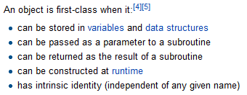

First-Class Events Objects to the rescue
How about a query library?
Or mocking for testing…?
Notes:
The great news is with Observables, we now have a concept of a first class event. What does that mean? Well, you can take one as an argument, you can return it from a function. What does that buy you exactly?

Slide 23
F R P
UNCTIONAL
EACTIVE
ROGRAMMING

Slide 24
Not to be confused with FRP
Tenets of FRP

Slide 25
C S P
OMMUICATING
EQUENTIAL
ROCESSES

Slide 26
CSP
List out letters

Slide 28
A Glimpse into the Future - RxJS and Generators
var Rx = require('rx');
var request = require('request');
var get = Rx.Observable.fromNodeCallback(request);
Rx.spawn(function* () {
var a = yield get('http://localhost/stocks1.csv').retry(3);
console.log(a.length);
try {
var b = yield get('http://invalidhost');
} catch (e) {
console.log(e.code);
}
});

Slide 29

Notes:
Now there’s a lot out there about async/await in C#, generators in other languages such as Python. This is great stuff that we actively use because it helps us with our one and done kinds of things such as Web Service calls, and any other async code, without having nasty callbacks all over the place.

Slide 30
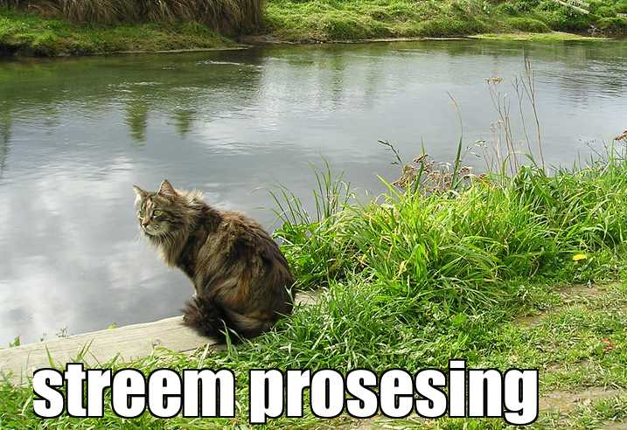
Notes:
Now, what we’re really talking about here is stream processing and what benefits you can get from it.

Slide 31

Notes:
Node Streams 1
http://nodejs.org/docs/v0.11.5/api/stream.html#stream_compatibility_with_older_node_versions
https://github.com/substack/stream-handbook
https://www.exponential.io/blog/nodeday-2014-state-of-node
http://strongloop.com/strongblog/practical-examples-of-the-new-node-js-streams-api/

Slide 32
Notes:
Node Streams 2

Slide 33
Notes:
Node Streams 3

Slide 34

Notes:
https://whatwg.github.io/streams/
http://wiki.whatwg.org/wiki/Streams

Slide 35
Notes:
https://api.dartlang.org/apidocs/channels/stable/dartdoc-viewer/dart-async

Slide 36



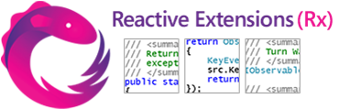

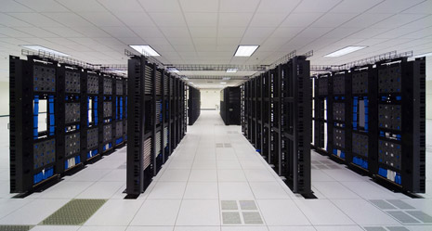
Real-time is everywhere…
RSS feeds
GPS
Stock tickers
Server management
UI events
Social media
Notes:
The world of application development is changing, we are constantly connected to any number of data sources at once. Take for example your phone, it gets texts, GPS, twitter updates, accelerometer movements, and many more things. In fact, it’s hard to find a modern app or device that doesn’t have many connections to it.
This data of course comes in many forms, whether it is stock tickers, RSS feeds, GPS feeds, servers, mouse events and even social media. All of these of course, are databases in one form or another, but in some cases the data just doesn’t exist yet. This mouse here in my hand is a database, as it has infinite amounts of mouse movements clicks and other data, so wouldn’t be it nice to be able to write queries for it? Wouldn’t it be nice to say the same for all these data sources?
How do you do advanced queries over social media in order to see what’s trending
Lots of data over a small period of time that you want to react to
Now, let’s say you want to add another data source? Add in YouTube?
Reaction time is of the essence when dealing with real-time data (don’t want to know what’s trending 5 minutes ago, but *right now*)
Want to be able to compose this with any number of other data sources, either internally or externally (such as user’s interaction with the app, e.g., tagging and commenting)
Coordinating these data sources today is very difficult, and that’s the point of the Reactive Extensions, to unify them all

Slide 37



Top-rated Movies Collection
Func<User, IObservable<Video>> getTopRatedFilms = user =>
user.VideoLists
.Select(videoList =>
videoList.Videos
.Where(video => video.Rating === 5.0)).
Merge();
getTopRatedFilms(user)
.Subscribe(film => Console.WriteLine(film));
Notes:
For example, we could query Netflix, using their Observable API to get the top rated movies from the user’s list. We could use the C# expression syntax or extension methods, both work equally well here. We’ll do a select to get the videos, a where filter the ratings and then merge it into a single sequence. Then, we can subscribe to write out each film.

Slide 38
What if I told you…
…that you could create a drag event…
…with the almost the same code?
Notes:
Now, what if I told you, the Netflix API calls we just made, we could do pretty much the same thing with a mouse drag, all with almost the same code? Would you believe me?

Slide 39

Mouse Drags Collection
Func<Element, IObservable<Event<EventArgs>> getElementDrags = elmt =>
elmt.MouseDowns()
.Select(mouseDown =>
mainWindow.MouseMoves()
Where .TakeUntil(elmt.MouseUps()))
.Merge();
getElementDrags(image)
.Subscribe(pos => image.Position = pos);
Notes:
And it turns out we can. If we’re given an element, then imagine we had an extension method that exposed MouseDowns as an observable sequence, then we can use Select to map mouse downs to the mouse moves extension method, stopping when we hit mouse ups. Then we merge it all back together into a nice little sequence. Of course for you C# folks here, we could have used SelectMany and not needed the Merge, but that’s all SelectMany really is, Select and Merge.

Slide 40
Ordinary Interactive Programming
try {
foreach (var item in collection)
DoSomething();
}
catch (Exception e) {
HandleOrThrow(e);
}
DoCleanup();
OnNext(T)
OnError()
OnCompleted()
Notes:
Let’s take a look at some ordinary code that most everyone sees on a day to day basis. Note your programming language might be different, but the concepts are largely still the same. In this case, we’re looking at C#. We iterate over a collection by pulling each item, doing something with it, and handling exception and doing cleanup as necessary.
Logically, each of these concepts map directly from a pull based collection to a push based collection.
OnNext when you want to handle each item.
OnError when you need to handle exceptions
And OnCompleted to do any cleanup

Slide 41

That was the iterator pattern
Notes:
What we just saw was the iterator pattern which is pull based, made famous the world around in the Gang of Four book.
In that book, they also describe a pretty useful pattern turns out that it can be used for push based collections. That is the Subject/Observer pattern. Although it’s not spelled out directly in the book, we found that there is a deep relation between the iterator pattern and a generalized subject observer pattern, that they are duals of one another, push versus pull.

Slide 42
Making it push-based
IObservable<T> collection = ...
var obs = Observer.Create( onNext: x => DoSomething(x), onError: e => HandleError(e), onCompleted: () => DoCleanup());
var subscription = collection.Subscribe(obs);
// deterministically cleans up all resources subscription.Dispose();
Notes:
So, how did we generalize the subject/observer pattern? We’ll break it down into two concepts, the Observer and the Observable.
In the case of Rx, the observable does not need to keep track of all observers. So, they are as decoupled as possible.
Let’s look at some C# code to make this concrete. First, we have an collection of type IObservable<T> which produces values. Next, we create an Observer which will later consume the Observable. We’ll create the observer with three callbacks, one for each new element that is pushed through the collection, an optional error handler, and optional completion handler.
Now how do we connect them? We simply call subscribe passing in the observer that we just created. Now, what we get back is a handle to the subscription.
Donna: Why do we need a handle? Aren’t we done?
There’s no unsubscribe from the Observable, instead, we have a subscription handle which contains all the logic in order to deregister the observer from the observable, so it’s completely decoupled. Not only that, but if we’re dealing with events, then during creating, we add a handle to an event, and in dispose, we remove the event handler.
Taking this a step further, if you combine multiple events together, then disposing the subscription will DETERMINISTICALLY get rid of ALL the resources associated with the subscription, for example all the event handlers at once.

Slide 43
Rx Grammar Police
* ( | ) ?
OnNext
Zero or more values
E.g. events are ∞ sequences
OnError
Calls can fail
OnCompleted
Resource management
Sequencing
ü
0
1
2
ü
0
1
2
ü
Must be a sequence
No concurrent callbacks
One time termination
0
1
û
0
2
1
Notes:
We talked about the three parts of the operation, the onNext, onError and onCompleted.
The onNext will be called zero to infinite times producing values
The onError handler will be at most called once should an operation fail such as a web request
The onCompeted handler will also be called at most once at the end of an operation if there is one.
Why do we need a grammar to formalize this?
Reason for grammar:
in interactive programming, know exactly when you’re going to get the next element
since elements are spaced out over time, we make the grammar explicit
this is the exact same grammar as a pull-based collection (if there’s an error, can’t get more elements, can’t get to the end twice

Slide 44
Observables are awaitable…
static async Task<int> DoStuff()
{
var observable = Observable.Return(42);
return await observable;
}
static async void GetStuff()
{
var value = await DoStuff();
Console.WriteLine(value);
}
Notes:
And sure enough, with the Reactive Extensions, you can easily use async/await within your application which gets the last value from the observable sequence. Pretty handy! So once again, it’s easy to keep using the Reactive Extensions and mixing that with Task based upon what you’re trying to do.

Slide 45
Notes:
Of course some might say use Task<T> only for a lot of things, and I couldn’t disagree more. For example, how about simple retries? With Rx, you get all of that with extension methods such as Retry, Catch, OnErrorResumeNext

Slide 46
Observables are more powerful…
async Task<int> GetMovies()
{
var observable = service.GetMovies().Retry(3)
return await observable;
}
async void ProcessMovies()
{
var movies = await GetMovies();
Console.WriteLine(movies.Count);
}
Notes:
And sure enough, with the Reactive Extensions, you can easily use async/await within your application which gets the last value from the observable sequence. Pretty handy! So once again, it’s easy to keep using the Reactive Extensions and mixing that with Task based upon what you’re trying to do.

Slide 47
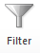
Marble diagram: filter
dots
.filter(function (dot) {
return dot.isOrange();
})
results
Notes:
Let’s look at a graphical representation of how some of the operators behave. This is what we call a marble diagram, which just shows the order in which elements are received.
Here, let’s filter the sequence and return only the orange marbles. (this is JavaScript code) Notice that we filter each element as it is received, rather than what we could do in a pull collection which would be to process all the elements and return a new filtered list.
So, the results observable will receive an OnNext at essentially the same time that the orange items came in the source sequence.

Slide 48
Marble diagram: map
input
map( => )
.map(function (item) {
return transform(item);
})
results
Notes:
So another classic functional operator is map. And, it behaves pretty much like you expect.
Let’s apply a map function that turns the circles into triangles. Again, just like with filter, we get each new observable element in the same order and about the same as the source sequence (modulo the time it takes to actually run the map operation)

Slide 49

Marble diagram: delay
Since Observables are asynchronous, they have a notion of time
input
.delay(1000)
results
Notes:
Since all of these queries have some notion of time (either implicit or explicit), there are also operators that directly involve time, such as delay. So here’s a graphical representation of what that might look like.

Slide 50
OnNext: Drag and Drop
Notes:
Now let’s take the code in action.

Slide 51


Composing Events and Promises
Observable of strings
XHR web service request
keyup
Dictionary web service
React
Reaction
Reactive
Reactor
Data binding on HTML page
Observable of arrays of words
Notes:
The Reactive Extensions could also be used in a typeahead or autosuggest scenario. What’s seemingly a pretty easy concept can get bogged down in the details.
As we start typing, we listen to they keyup event which would produce an Observable of strings
Next, we’re going to take the data and send it to a Dictionary service via a Promise, which we can convert to an observable sequence which will have at most one element. But we have to be mindful in cloud scenarios where bandwidth is money and we don’t want to introduce too much latency by overwhelming the service as we type.
Then we’ll get back an Observable array of data which we can then bind to the page easily .
Now how does that work?

Slide 52
Composing Events and Promises
DOM events as a sequence of strings
var words = Rx.DOM.keyup(input)
.map(function() { return input.value; })
.throttle(500)
.distinctUntilChanged()
.flatMapLatest( function(term) { return search(term); } );
words.subscribe(function(data) {
// Bind data to the UI
});
Reducing data traffic / volume
Latest response as word arrays
Web service call returns single value sequence
Binding results to the UI
Notes:
By using the DOM bindings, we can extract the keyup events from the input by using the Rx.DOM.fromEvent function. Then we can extract the value from the textbox through the map function.
As we said before, we don’t want to overload the service with requests for every key we type, instead we only want to make sure we wait for a pause of half a second, and ensure we are firing when text has truly changed. Keys such as arrows don’t change the text itself, therefore the observable sequence won’t fire.
Next we need to take the throttled input and query the dictionary service. Proper handling of asynchronous behavior is important and order matters. If I type react then type reactive, yet reactive comes back first, we don’t want to have the result from our first request to clobber the results from our last. That’s a typical mistake I see in a lot of applications. To fix that, we call flatMapLatest in which your map function returns an observable of observables and then flatMapLatest cancels all previous requests and only returns the latest value.

Slide 53
Testing concurrent code: made easy!
var scheduler = new TestScheduler();
var input = scheduler.createColdObservable( onNext(300, "NDC"), onNext(400, "OSLO"), onCompleted(500));
var results = scheduler.startWithCreate(function () { input.map(function (x) { return x.length; }) });
results.messages.assertEqual( onNext(300, 3), onNext(400, 4), onCompleted(500));
Notes:
Writing asynchronous code in any language is hard enough, but testing it can be a nightmare. You could be caught in thread sleeps or timers to test whether asynchronous behavior happened.
The Reactive Extensions solves this through a virtual time scheduler. There are a number of them built in including an HistoricalScheduler for replaying historical data, but also there’s a (click) TestScheduler whose sole purpose is to provide a mechanism for deterministic testing without having to create any artificial delays.
(click)
We can also simulate observables which fire at predefined virtual times with values. This happens all in real time, no waiting required. I could in fact schedule something for the next CodeMash next year and deterministically check that my code does the right thing. Here, we’re creating an observable with two elements, strange and loop to fire at 300 milliseconds and loop to fire at 400, and a completion message at 500 ticks or virtual time.
(click)
We can get the results from our query of getting the length of each string by using the scheduler which tracks all the values and when they were produced with a virtual timestamp.
(click)
Finally, we can verify the results that at 300 milliseconds, we get a string with length of 7 and at 400 milliseconds a string of length 4 and a completion message at 500 milliseconds.
You could turn an Enumerable into an Observable such as test data from a file, and you don’t have to make your code convoluted just to make it testable.
This style we show here is exactly how we wrote our unit tests for all of our operators.

Slide 54
Client: Polling for Row Updates
function getRowUpdates(row) {
var scrolls = Rx.Observable.fromEvent(document, "scroll");
var rowVisibilities =
scrolls.throttle(50)
.map(function (scrollEvent) { return row.isVisible(scrollEvent.offset); })
.distinctUntilChanged()
.publish().refCount();
var rowShows = rowVisibilities.filter(function (v) { return v; });
var rowHides = rowVisibilities.filter(function (v) { return !v) });
return rowShows
.flatMap(Rx.Observable.interval(10))
.flatMap(function () { return row.getRowData().takeUntil(rowHides); })
.toArray();
};
Notes:
So, how do we poll for updates on the client based upon scrolling?
We start off by getting the scrolls, then we get the row visibilities, throttling it just a little bit so that we’re not firing it too many times, then we’re going to determine whether the row is visible, make sure it’s distinct (meaning true/false), and then share it out to the world.
We can then create rowShows and rowHides streams based upon whether it is visible or not.
Now, it’s just simple composition, take the row shows, chain it to an interval of 10 ms, then chain it to getting the row data, until the row is hidden. Finally, returning it all as an Observable of an array.

Slide 55
Server: Retrieving Social Row
IObservable<List<dynamic>> GetSocialRowData() {
return Observable.RelationalJoin(
socialService.GetFriends(user),
messageService.GetNotifications()
.Where(notification => notification.Video.IsAvailable),
friend => friend.Id, // join key selector
notification => notification.Friend.Id, // join key
(friend, notification) =>
new {
Id = notification.Id,
Name = notification.Video.Name,
Message = notification.Message,
Friend = new { Name = friend.Name, Id = friend.Id }
}).
ToList();
}
Notes:
Now on the server, how about another kind of piece such as getting movies that I recommend to my friends? Say that I’m friends with you and I want to let you know you should watch this movie. How would that work on the server?
We can retrieve some social information, by using an operator we’re creating for Rx vNext for relational joins. Right now we have for time based joins, but Netflix went ahead and implemented a relational join and we’ll be incorporating it shortly. Anyhow, what we can get do get our friends, and get our notifications where video is available, joining on our friend’s ID.
Then we can project forward some information such as the name of the movie, the message, friend, etc, send it off as a Observable of a List.

Slide 56
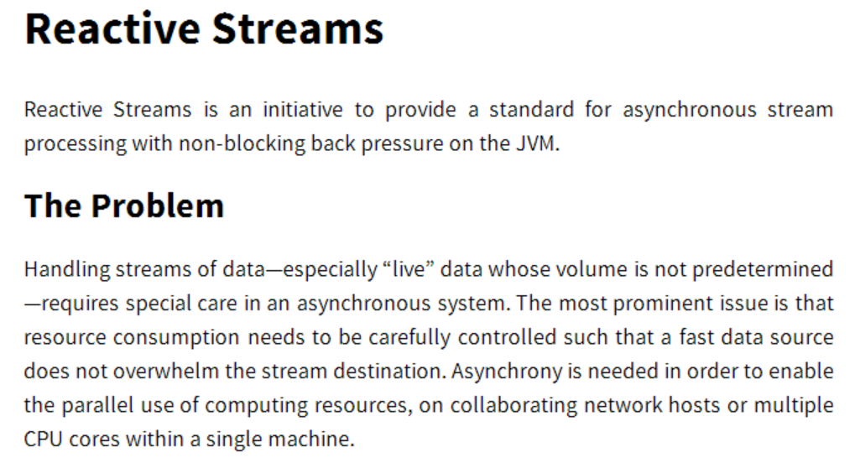
http://www.reactive-streams.org/

Slide 57
OnCompleted: Rx
Language neutral model with 3 concepts:
Observer/Observable
Query operations (map/filter/reduce)
Schedulers: a set of types to parameterize concurrency
@ReactiveX
github.com/Reactive-Extensions
rx.codeplex.com
https://github.com/Reactive-Extensions/NDC-Oslo-2014
Notes:
So, there you have it. Rx is the notion of an observable, a set of query operations, and schedulers to parameterize concurrency.
You can contact us on Twitter and we have a git repositories hosted on CodePlex and GitHub.
We take pull requests! We’re actively looking for contributions and samples and documentation.
Try out Rx in your favorite language and see what you think! Blog or tweet about your experience tell us what can be made better.

